Slide 1
Chapter 16 – Handling Time Series
Data Mining for Business Analytics in Python
Shmueli, Bruce, Gedeck & Patel

Slide 2
Main ideas
Forecast future values of a time series
Distinction between forecasting (main focus) and describing/explaining
Four components of time series:
Level
Trend
Seasonality
noise

Slide 3
Explain vrs. Predict
Explanation is the goal of “time series analysis”
Models are based on causal argument
Models are not “black-box”
Forecasting (our focus) seeks to predict future values

Slide 4
Import needed functionality
import pandas as pd
import matplotlib.pylab as plt
import statsmodels.formula.api as sm
from statsmodels.tsa import tsatools
from dmba import regressionSummary

Slide 5
Time Series Components
Level
Trend
Seasonality
Noise

Slide 6

Amtrak Ridership (monthly)
Level - about 1,800,000 passengers per month
Appears to have U-shaped trend

Slide 7
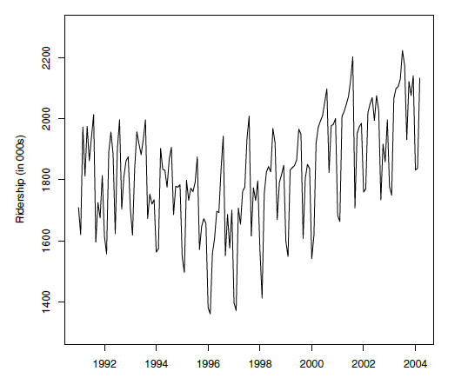
Amtrak Ridership

Slide 8
Python code for preceding plot
Amtrak_df = pd.read_csv('Amtrak.csv')
# convert the date information to a datetime object
Amtrak_df['Date'] = pd.to_datetime(Amtrak_df.Month, format='%d/%m/%Y')
# convert dataframe column to series (name is used to label the data)
ridership_ts = pd.Series(Amtrak_df.Ridership.values, index=Amtrak_df.Date,
name='Ridership')
# define the time series frequency
ridership_ts.index = pd.DatetimeIndex(ridership_ts.index,
freq=ridership_ts.index.inferred_freq)
# plot the series
ax = ridership_ts.plot()
ax.set_xlabel('Time')
ax.set_ylabel('Ridership (in 000s)')
ax.set_ylim(1300, 2300)

Slide 9
Visualize more carefully
Zoom in or out: Different patterns are discernible at different time period scales
Change y-scale: For example, change to logarithmic (ax.set_yscale(‘log’)) to check for exponential trend
Add trend line: Helps decide which trend (e.g. linear, exponential, quadratic) is best approximation
Suppress seasonality: Helps reveal more fundamental trends

Slide 10
Zoom in, add trend line
# create short time series from 1997 to 1999 using a slice
ridership_ts_3yrs = ridership_ts['1997':'1999']
# create a data frame with additional predictors from time series
# the following command adds constant, trend and quadratic trend terms
ridership_df = tsatools.add_trend(ridership_ts, trend='ctt')
# fit a linear regression model to the time series
ridership_lm = sm.ols(formula='Ridership ~ trend + trend_squared',
data=ridership_df).fit()
# shorter and longer time series
fig, axes = plt.subplots(nrows=2, ncols=1, figsize=(10,6))
ridership_ts_3yrs.plot(ax=axes[0])
ridership_ts.plot(ax=axes[1])
for ax in axes:
ax.set_xlabel('Time')
ax.set_ylabel('Ridership (in 000s)')
ax.set_ylim(1300, 2300)
ridership_lm.predict(ridership_df).plot(ax=axes[1])
plt.show()

Slide 11
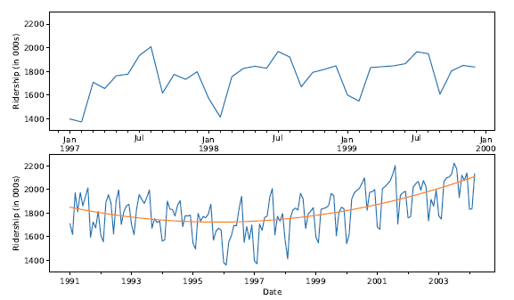
Zoom in, add trend line
Note that seasonality* (summer peaks) is revealed when you zoom in.
*Don’t confuse the time series term “season,” which is the period over which a cyclical pattern repeats (e.g. a year), with the standard English seasons of the year (fall, winter, etc.).

Slide 12
Partitioning
Divide data into training portion and validation portion
Test model on the validation portion
Performance can be assessed against the “naïve benchmark” – naïve forecast is simply the most recent value in the time series

Slide 13
Partitioning is not random
Random partitioning would leave holes in the data, which causes problems
Forecasting methods assume regular sequential data
Instead of random selection, divide data into two parts
Train on early data
Validate on later data
Partition ridership data, using last 36 records as validation
nValid = 36
nTrain = len(ridership_ts) - nValid
# partition the data
train_ts = ridership_ts[:nTrain]
valid_ts = ridership_ts[nTrain:]

Slide 14
Summary
Focus is to predict (not describe/explain)
Four components
Level
Trend
Seasonality
Noise
Partition data by dividing into early/late

